Slide 1
Overview of AWS DevOps

Slide 2
Agenda
Why / What AWS DevOps
Important AWS DevOps Services
Working with SDLC-Code Commit , Code Build , Code Deploy and Code Pipeline
Working with Cloudformation

Slide 3

What is AWS DevOps?
AWS provides a set of flexible services designed to enable companies to more rapidly and reliably build and deliver products using AWS and DevOps practices.
These services simplify provisioning and managing infrastructure, deploying application code, automating software release processes, and monitoring your application and infrastructure performance.

Slide 4
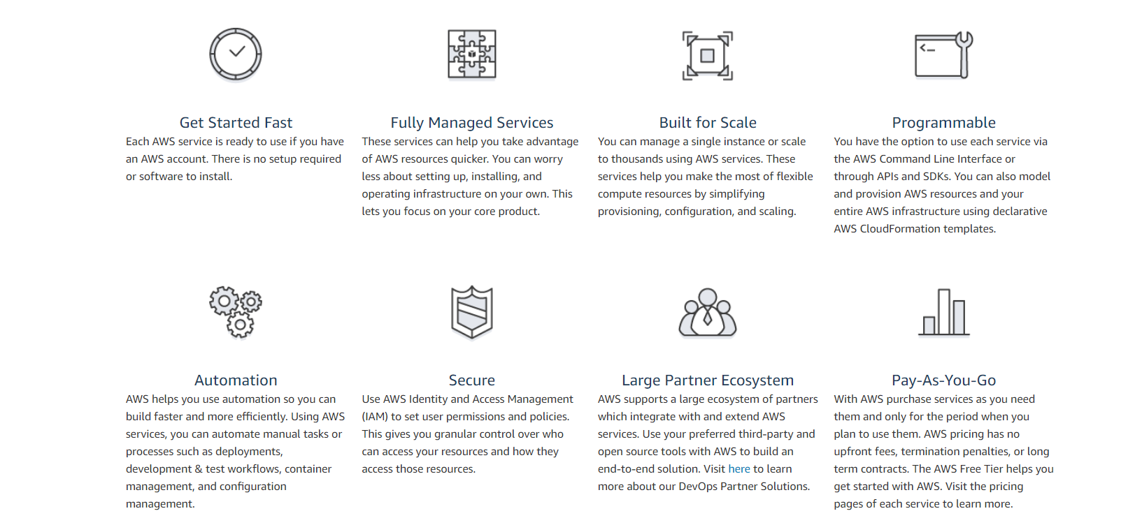
Why AWS DevOps?

Slide 5
IMPORTANT AWS DEVOPS SERVICES

Slide 6
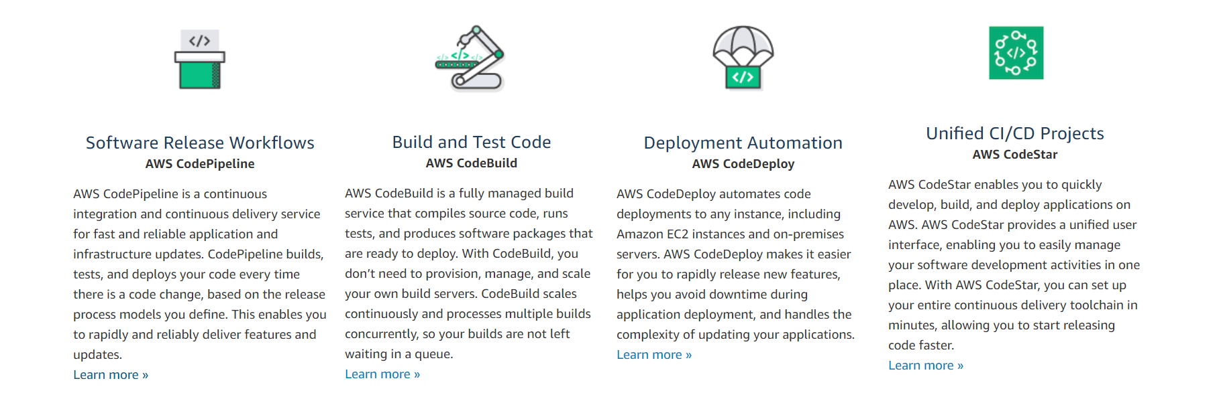
Continuous Integration and Continuous Delivery
The AWS Developer Tools help you securely store and version your application's source code and automatically build, test, and deploy your application to AWS or your on-premises environment.

Slide 7
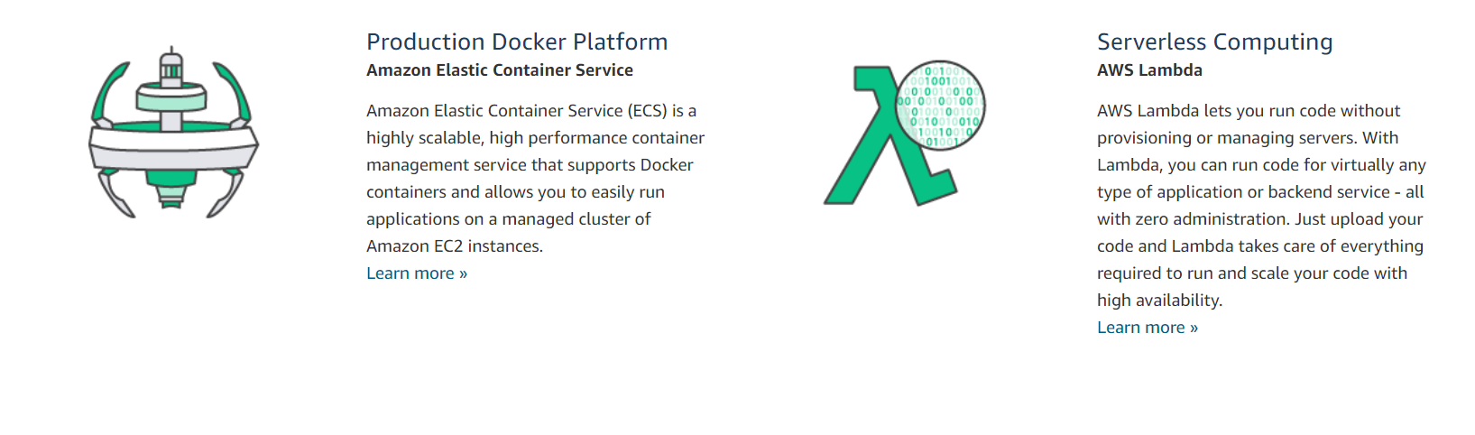
Microservices
Build and deploy a Microservices architecture using containers or serverless computing.

Slide 8
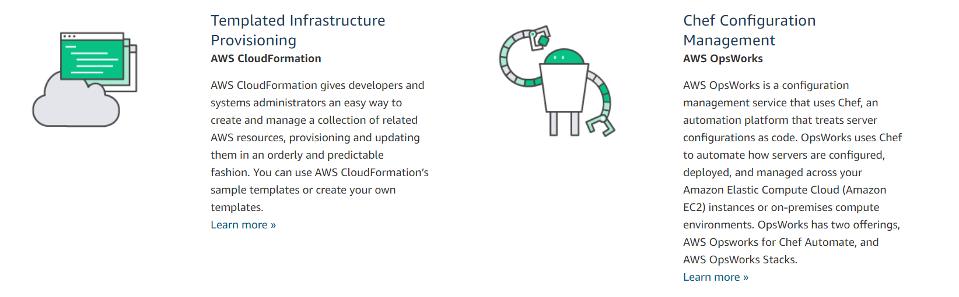
Infrastructure as Code
Provision, configure, and manage your AWS infrastructure resources using code and templates. Monitor and enforce infrastructure compliance.

Slide 9
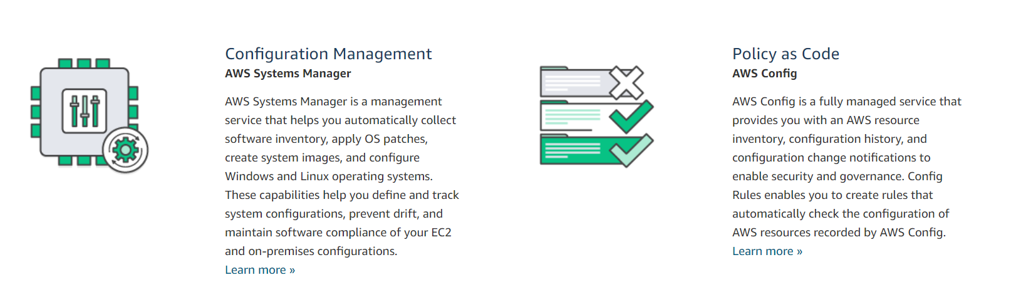
Infrastructure as Code
Monitor and enforce infrastructure compliance

Slide 10
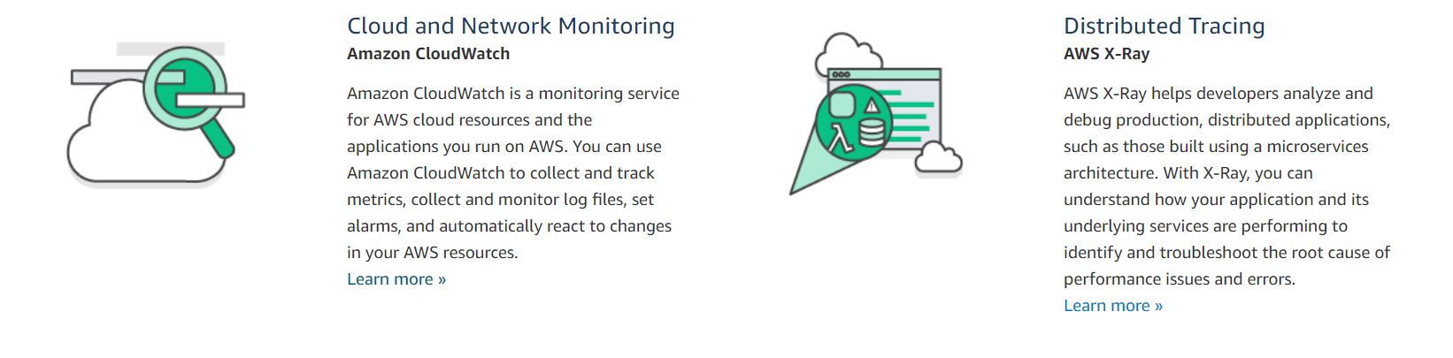
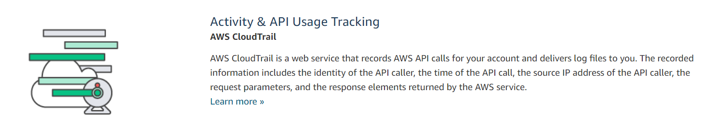
Monitoring and Logging
Record logs and monitor application and infrastructure performance in near real-time.

Slide 11
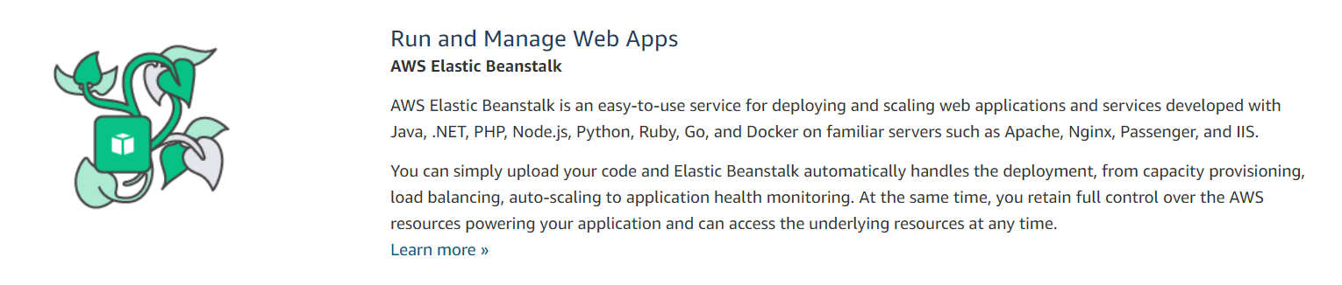
Platform as a Service
Deploy web applications without needing to provision and manage the infrastructure and application stack

Slide 12
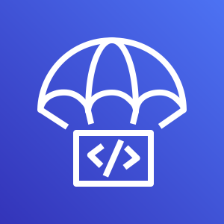
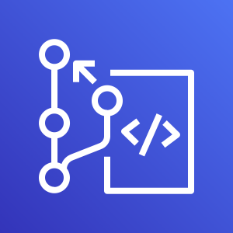

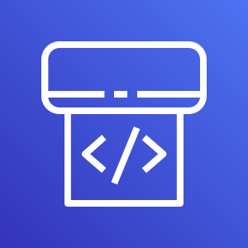
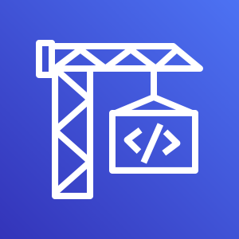
AWS Developer Tools
For Continuous Deployment
For Version Control
CodeDeploy
CodeCommit
For Continuous Integration
For Continuous Delivery
CodePipeline
CodeBuild

Slide 13

Overview of Code Commit
For Version Control
Fully-managed source control service that hosts secure Git-based repositories.
Makes it easy for teams to collaborate on code in a secure and highly scalable ecosystem.
Eliminates the need to operate your own source control system or worry about scaling its infrastructure.
Securely store anything from source code to binaries, and it works seamlessly with your existing Git tools.

Slide 14
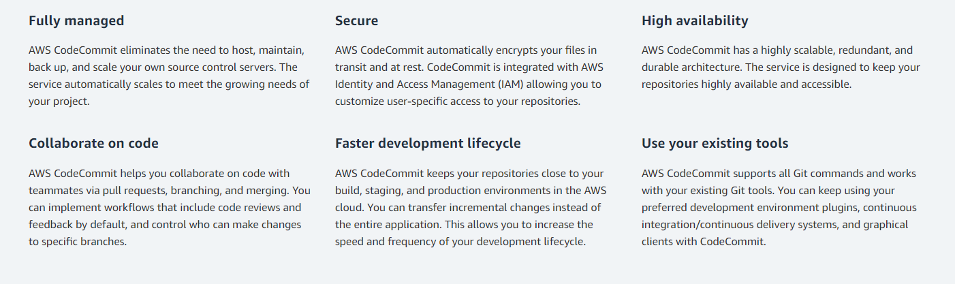
Overview of Code Commit
For Version Control
CodeCommit

Slide 15
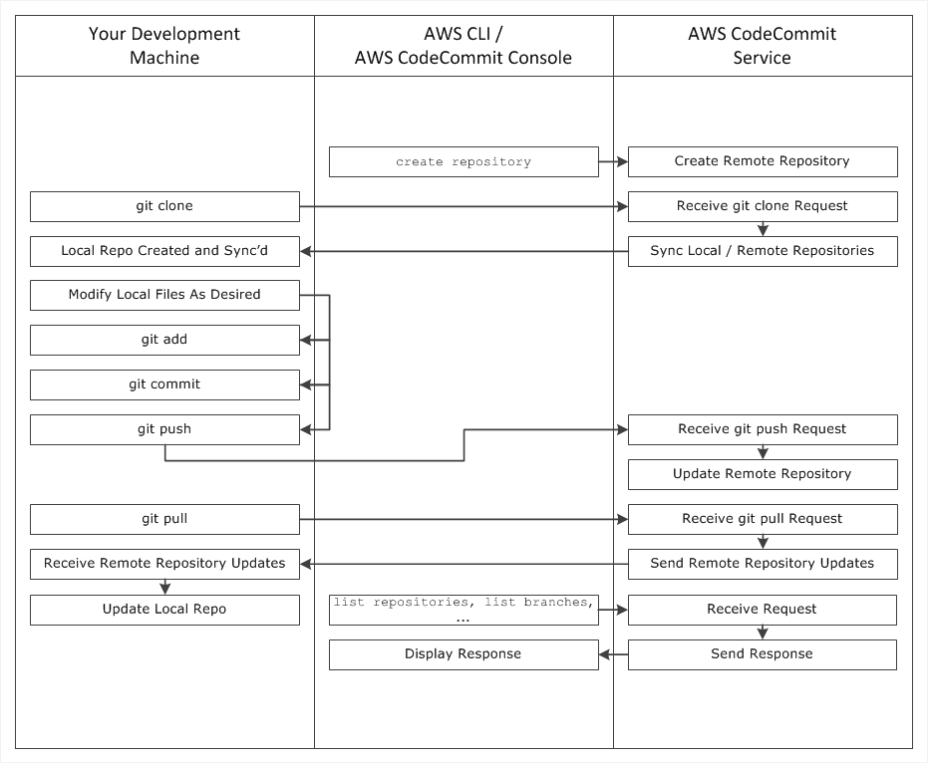
Working of Code Commit
For Version Control

Slide 16
Working with Branches
In Git, branches are simply pointers or references to a commit.
Convenient way to organize your work by using branches to separate work impacting work in other branches.
Used for developing new features, storing a specific version of the project from a particular commit
In Code Commit, one can change the default branch for your repository.
Default branch is the one used as the base or default branch in local repos when users clone the repository.
Creating , deleting and viewing branch details is possible in Code commit

Slide 17
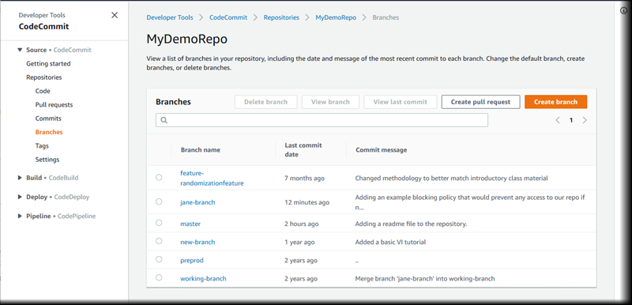
Branches in Code Commit

Slide 18
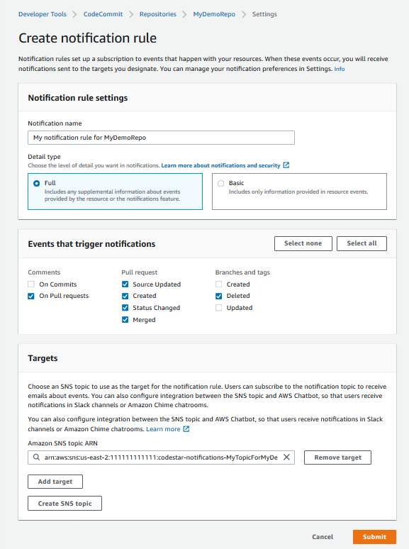
Configuring Notifications in AWS Code Commit
Set up notification rules for a repository so that repository users receive emails about the repository event types you specify.
Notifications are sent when events match the notification rule settings.
Create an Amazon SNS topic to use for notifications using AWS Console or CLI.

Slide 19

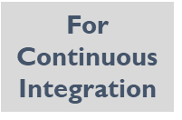
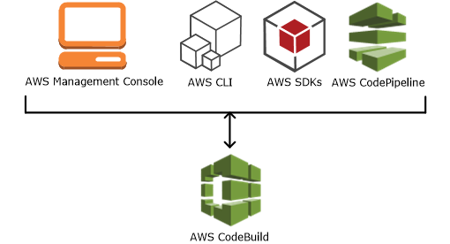
Overview of Code Build
Fully managed continuous integration service that compiles source code, runs tests, and produces software packages that are ready to deploy.
No need to provision, manage, and scale your own build servers.
Scales continuously and processes multiple builds concurrently.
Create custom build environments that use your own build tools.
With CodeBuild, you are charged by the minute for the compute resources you use.

Slide 20
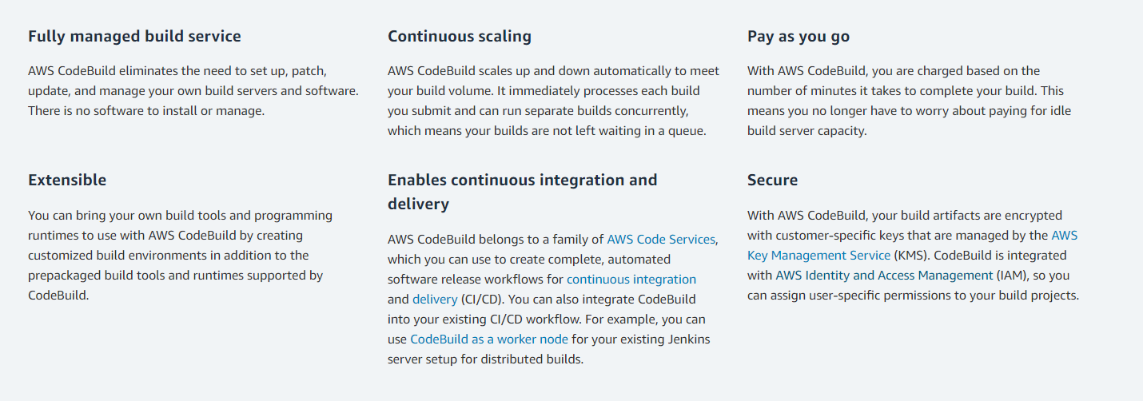
Overview of Code Build

Slide 21
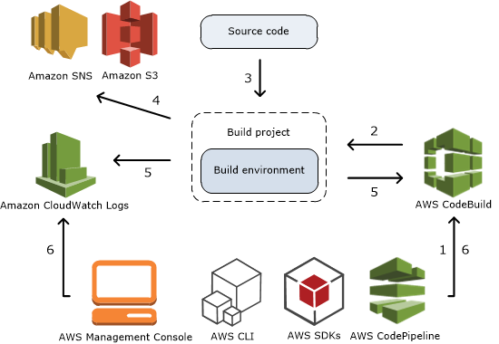
How Code Build Works
Ref: https://docs.aws.amazon.com/codebuild/latest/userguide/concepts.html

Slide 22
Build Specification for Code Build
A buildspec is a collection of build commands and related settings, in YAML format, that Code Build uses to run a build.
Include buildspec as part of the source code or can be defined in a buildspec when project is built.
Build Spec has the below format:
version: 0.2
run-as: Linux-user-name
env:
variables:
parameter-store:
exported-variables:
phases:
install:
run-as: Linux-user-name
artifacts:
files:
Ref: https://docs.aws.amazon.com/codebuild/latest/userguide/build-spec-ref.html

Slide 23
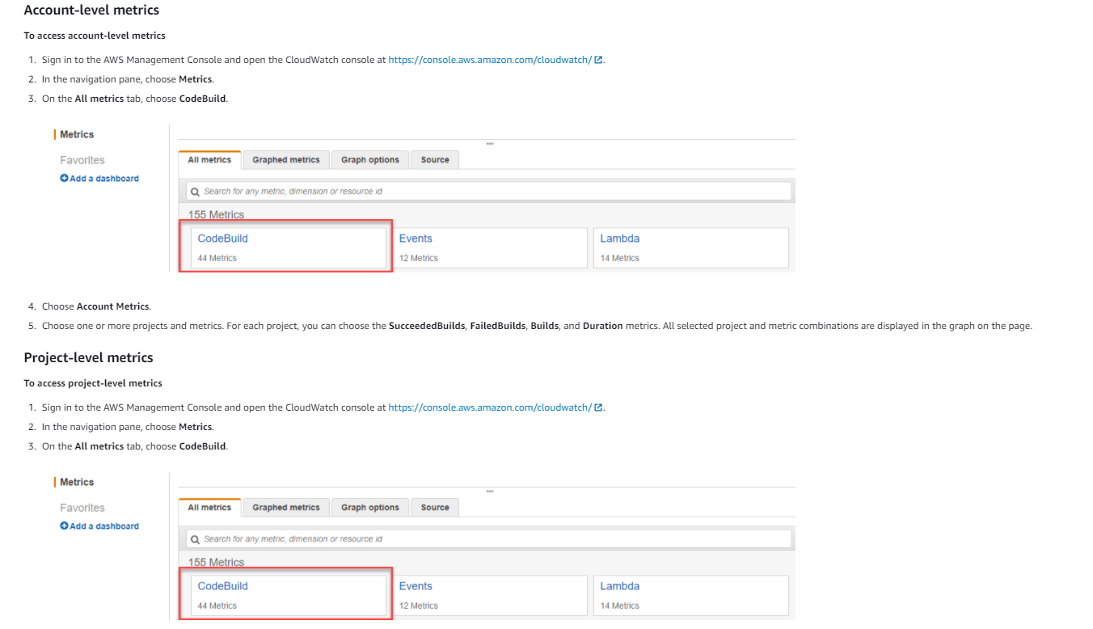
Monitoring Code Build Metrics
AWS Code Build monitors functions on your behalf and reports metrics through Amazon CloudWatch. These metrics include the number of total builds, failed builds, successful builds, and the duration of builds.

Slide 24
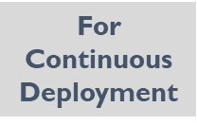
Overview of AWS Code Deploy
Fully managed deployment service that automates software deployments to a variety of compute services such as Amazon EC2, AWS Fargate, AWS Lambda, and on-premises servers.
Makes it easy to rapidly release new features , avoid downtime during application deployment, and handles the complexity of updating applications.
It is used to automate software deployments, eliminating the need for error-prone manual operations
Highly Scalable service

Slide 25
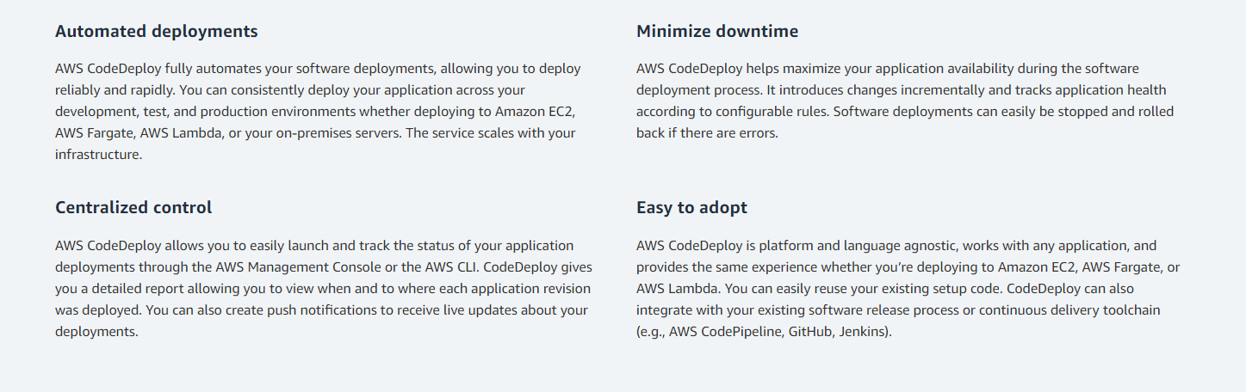
Overview of Code Deploy

Slide 26
Important Terms
An application is a collection of software and configuration to be deployed to a group of instances.
A revision is a specific version of deployable content, such as source code, post-build artifacts, web pages, executable files, and deployment scripts, along with an AppSpec file.
The AWS Code Deploy Agent can access a revision from GitHub or an Amazon S3 bucket.
A deployment group is the AWS Code Deploy entity for grouping EC2 instances or AWS Lambda functions in a Code Deploy deployment. For EC2 deployments, it is a set of instances associated with an application that you target for a deployment.
A deployment configuration specifies how the behavior for how deployment should proceed, including how to handle deployment failure, through for a deployment group.

Slide 27
CodeDeploy – AppSpec file
An AppSpec file is a configuration file that specifies the files to be copied and scripts to be executed. It uses uses the YAML format, and can be include it in the root directory of revision.
Eg: The AppSpec file is used by the AWS CodeDeploy Agent and consists of two sections.
The files section specifies the source files in your revision to be copied and the destination folder on each instance.
The hooks section specifies the location of the scripts to run during each phase of the deployment.
version: 0.0
os: windows
files:
- source: \index.html
destination: C:\inetpub\wwwroot
hooks:
BeforeInstall:
- location: \before-install.bat
timeout: 900

Slide 28
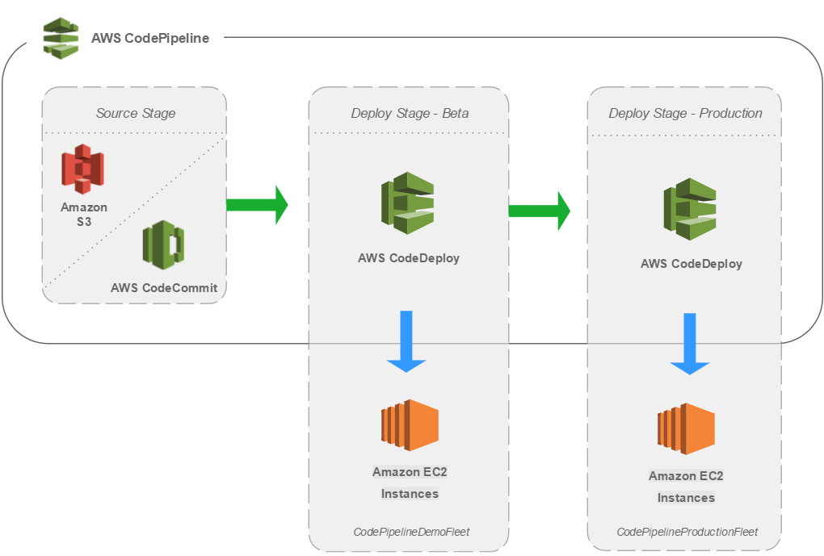
Working of Code Deploy

Slide 29
Code Deploy- Deployment Types
In-place deployment: The application on each instance in the deployment group is stopped, the latest application revision is installed, and the new version of the application is started and validated. Only deployments that use the EC2/On-Premises compute platform can use in-place deployments.
The blue/green deployment type uses the blue/green deployment model controlled by CodeDeploy. This deployment type enables you to verify a new deployment of a service before sending production traffic to it.
3 methods using which traﬃc can shift during a blue/green deployment:
Canary — Traﬃc is shifted in two increments but not equally be mentioning the percentage of traffic and interval before remaining traffic is shifted in second environment.
Linear — Traﬃc is shifted in equal increments with an equal number of minutes between each increment.
All-at-once — All traﬃc is shifted from the original task set to the updated task set all at once.

Slide 30
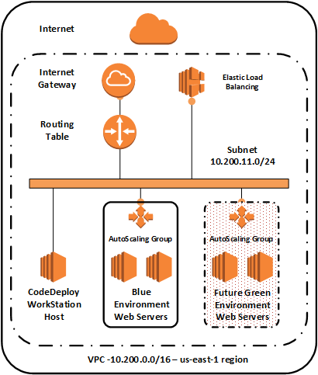
Benefits of Blue/Green Deployments
Blue/green deployment involves two production environments:
Blue is the active environment.
Green is for the release of a new version.
Advantages of a blue/green deployment:
Perform testing on the green environment without disrupting the blue environment.
Switching to the green environment involves no downtime. It only requires the redirecting of user traffic.
Rolling back from the green environment to the blue environment in the event of a problem is easier because you can redirect traffic to the blue environment without having to rebuild it.
Ref:https://aws.amazon.com/blogs/devops/performing-bluegreen-deployments-with-aws-codedeploy-and-auto-scaling-groups/

Slide 31
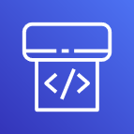
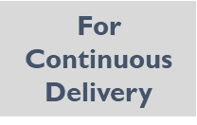
What is AWS CodePipeline?
Fully Managed Continuous Delivery service
Automates the Build, Test, and Deploy phases of release process
Enables to rapidly and reliably deliver features and updates.
Easily integratable with with third-party services such as GitHub
Pay only for what you use

Slide 32
Benefits of CodePipeline
Rapid Delivery of new features
Fully Managed Service - No need to provision or setup servers
Multiple options for configuring workflows – AWS Console, AWS CloudFormation , AWS CLI and SDKs
Provides easy integration with third-party tools

Slide 33
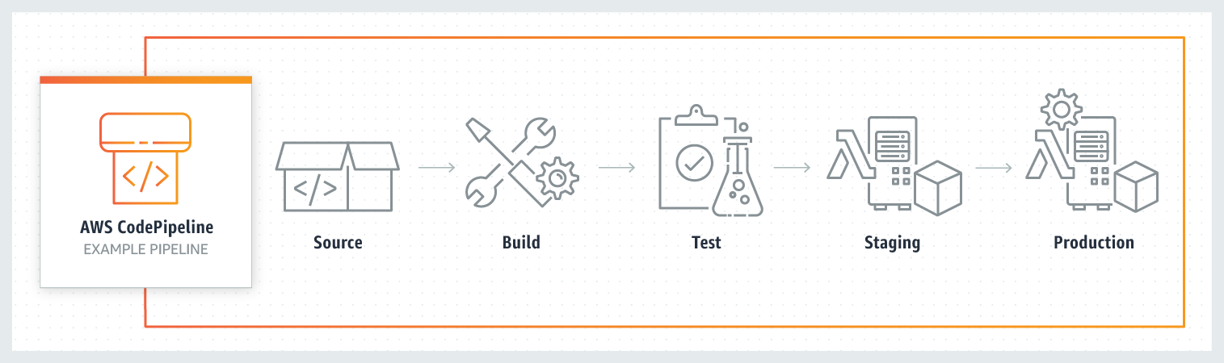
Working of CodePipeline

Slide 34
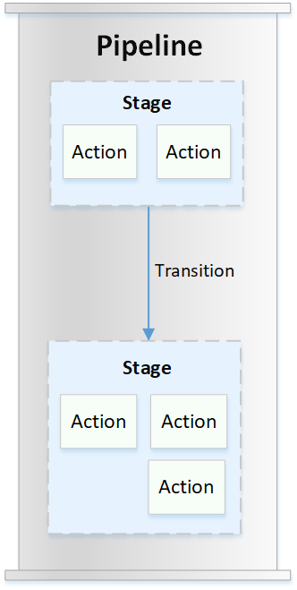
Important Terms
Pipelines
A pipeline is a workflow construct that describes how software changes go through a release process. Each pipeline is made up of a series of stages.
Stages
A stage is a logical unit you can use to isolate an environment and to limit the number of concurrent changes in that environment.
Actions
An action is a set of operations performed on application code and configured so that the actions run in the pipeline at a specified point.
Valid CodePipeline action types are source, build, test, deploy, approval, and invoke.
Pipeline executions
An execution is a set of changes released by a pipeline. Valid statuses for pipelines are InProgress, Stopping, Stopped, Succeeded, Superseded, and Failed.

Slide 35
Important Terms
Transitions
A transition is the point where a pipeline execution moves to the next stage in the pipeline.
Artifacts
Artifacts refers to the collection of data, such as application source code, built applications, dependencies, definitions files, templates, and so on, that is worked on by pipeline actions.
Source revisions
When you make a source code change, a new version is created. A source revision is the version of a source change that triggers a pipeline execution.

Slide 36
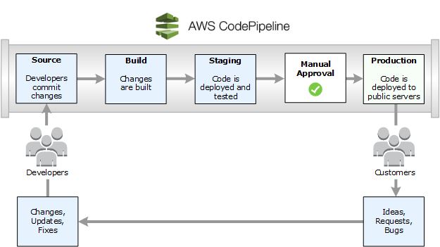
Overview of AWS CodePipeline
Ref: https://docs.aws.amazon.com/codepipeline/latest/userguide/welcome-introducing.html

Slide 37
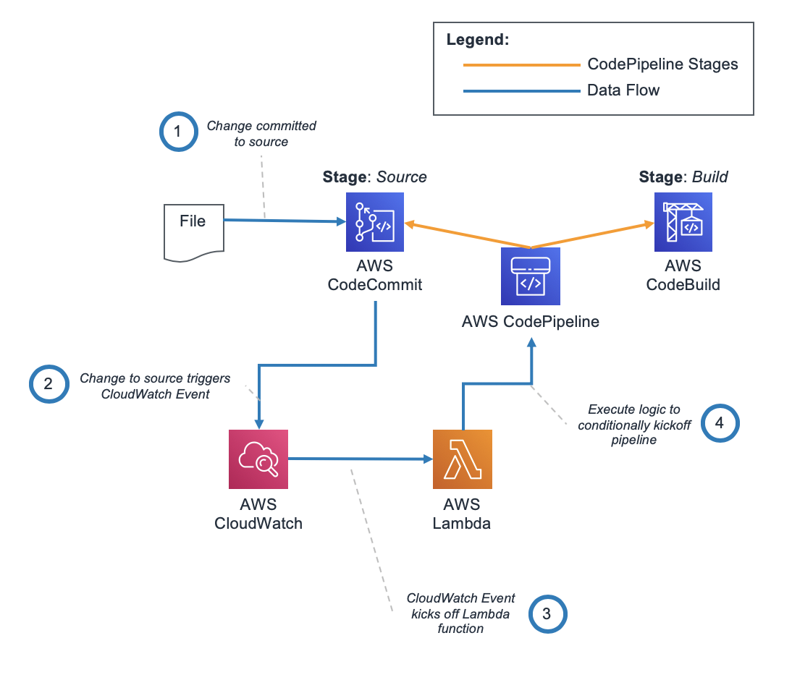
Sample Code Pipeline Architecture
Ref: https://aws.amazon.com/blogs/devops/adding-custom-logic-to-aws-codepipeline-with-aws-lambda-and-amazon-cloudwatch-events/

Slide 38
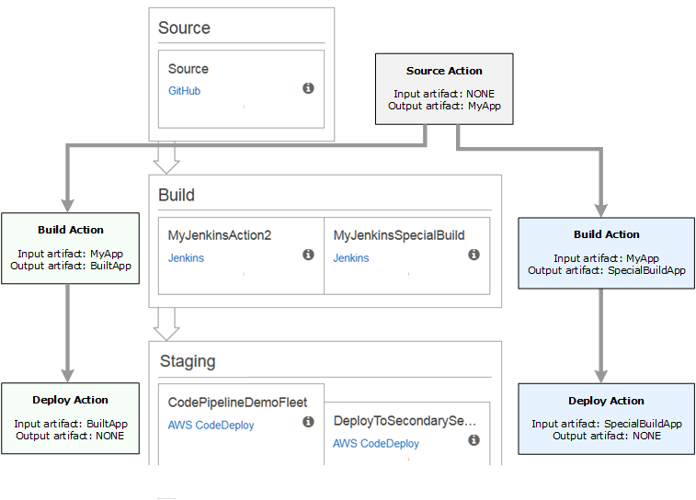
Input and Output Artifacts
Code Pipeline integrates with development tools to check for code changes and then build and deploy through all of the stages of the continuous delivery process.
Stages use input and output artifacts that are stored in the Amazon S3 artifact bucket you chose when you created the pipeline.
Code Pipeline zips and transfers the files for input or output artifacts as appropriate for the action type in the stage.

Slide 39
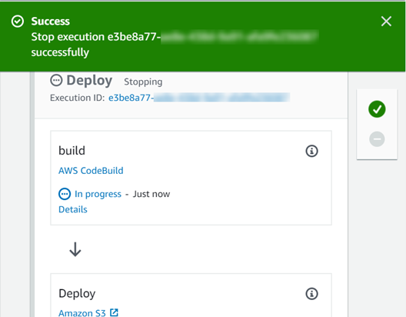
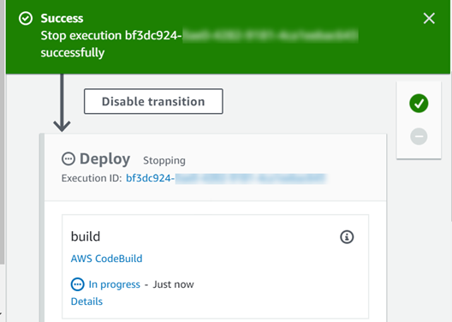
Working of Pipeline Executions
Tracks each pipeline execution that starts when a change is made to the source code.
Also tracks the way each execution progresses through the pipeline, including whether it is superseded by another execution.
Stop and Wait
Stop and Abandon
Ref:https://docs.aws.amazon.com/codepipeline/latest/userguide/concepts-how-it-works.html

Slide 40
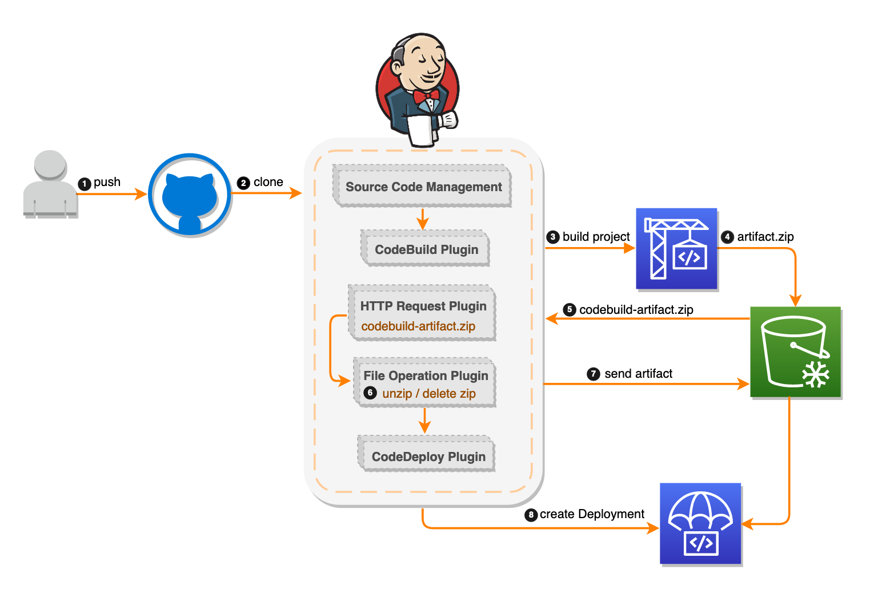
CI/CD Pipeline by Integrating Jenkins with AWS
Ref:https://aws.amazon.com/blogs/devops/setting-up-a-ci-cd-pipeline-by-integrating-jenkins-with-aws-codebuild-and-aws-codedeploy/

Slide 41
AWS CloudFormation
1

Slide 42
What is CloudFormation
3
AWS CloudFormation provides a common language for you to describe and provision all the infrastructure resources in your cloud environment.
CloudFormation allows you to use a simple text file to model and provision, in an automated and secure manner, all the resources needed for your applications across all regions and accounts. This file serves as the single source of truth for your cloud environment.
AWS CloudFormation is available at no additional charge, and you pay only for the AWS resources needed to run your applications.

Slide 43
Benefits of CloudFormation
All In One
Deploy and Automate
Infrastructure as a Code

Slide 44
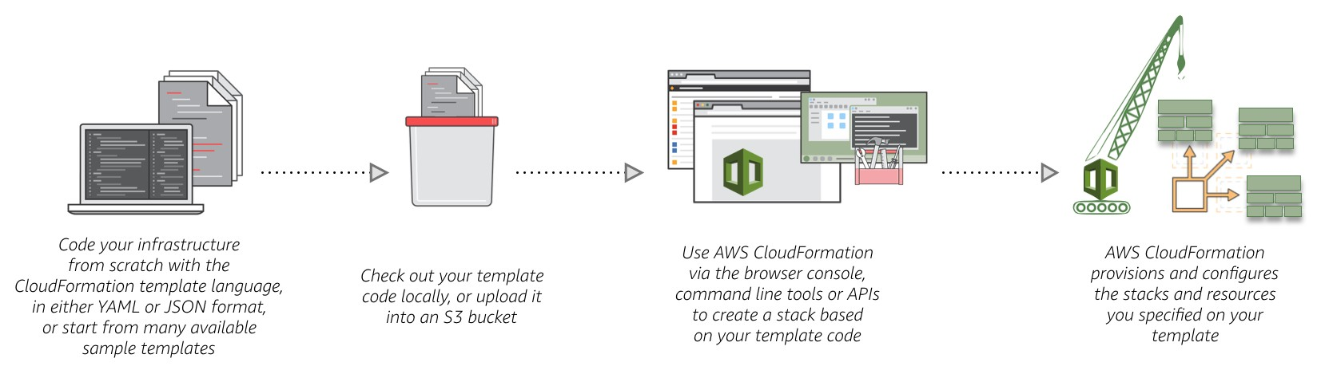
How it Works ?
7

Slide 45
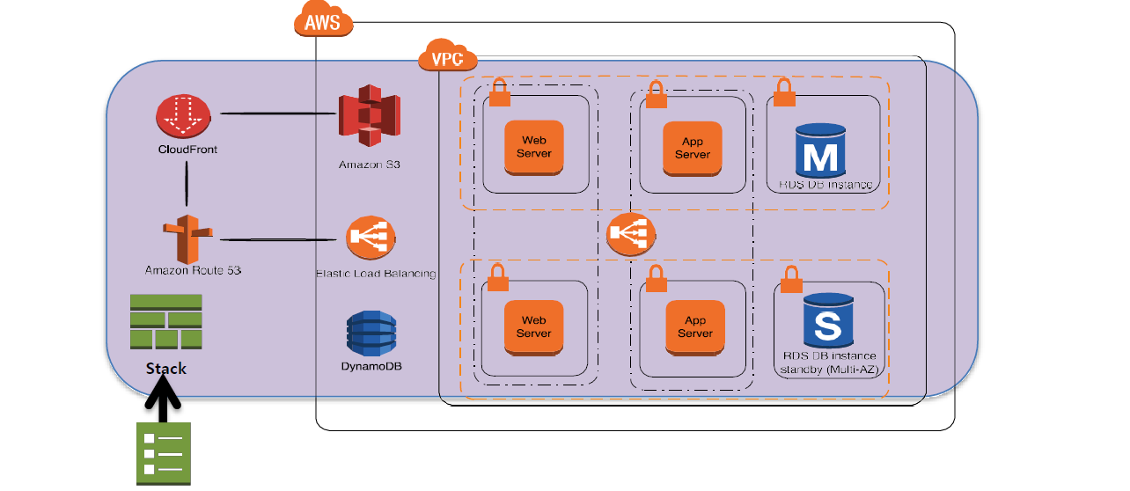
What is CloudFormation Stack
A stack is a collection of AWS resources that you can manage as a single unit.
Create, Update or Delete a collection of resources by creating, updating, or deleting stacks.
All the resources in a stack are defined by the stack's AWS CloudFormation template.

Slide 46
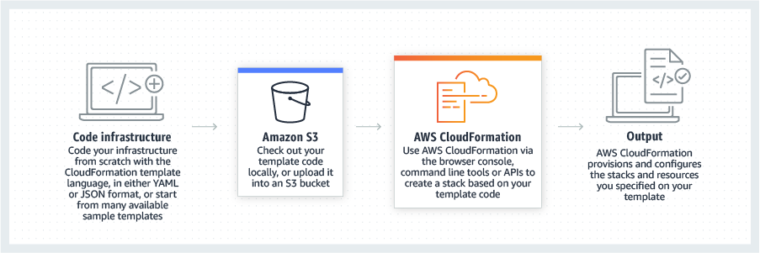
Working with CloudFormation Templates
AWS Cloud Formation Templates helps to define and model AWS resources that can be created and updated.
Templates are written in a format called JavaScript Object Notation (JSON).
Requires a specific syntax and structure that depends on the types of resources being created and managed.
Using templates helps to provision infrastructure in a repeatable and reliable way.
Once templates are deployed or updated into the AWS environment, the collection of resources under management is called a “stack.”
Stacks can be managed through the AWS Management Console, AWS Command Line Interface, or AWS CloudFormation APIs.

Slide 47
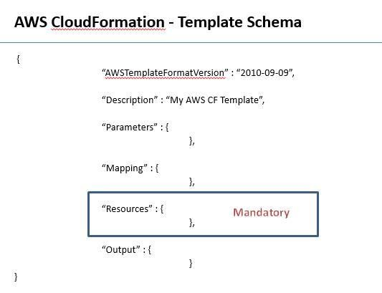
Overview of CloudFormation Template
A template is a JSON- or YAML-formatted text file that describes your AWS infrastructure. The 6 objects of Template is given below
Format version
Description
Parameters
Mappings
Resources (Mandatory)
Outputs

Slide 48
Template Anatomy
Format Version (optional)
The AWS CloudFormation template version that the template conforms to. T
Description (optional)
A text string that describes the template. This section must always follow the template format version section.
Metadata (optional)
Objects that provide additional information about the template.
Parameters (optional)
Values to pass to your template at runtime (when you create or update a stack). Y
Mappings (optional)
A mapping of keys and associated values that you can use to specify conditional parameter values, similar to a lookup table.

Slide 49
Template Anatomy
Conditions (optional)
Conditions that control whether certain resources are created or whether certain resource properties are assigned a value during stack creation or update.
Transform (optional)
For serverless applications (also referred to as Lambda-based applications), specifies the version of the AWS Serverless Application Model (AWS SAM) to use.
Resources (required)
Specifies the stack resources and their properties, such as an Amazon Elastic Compute Cloud instance or an Amazon Simple Storage Service bucket.
Outputs (optional)
Describes the values that are returned whenever you view your stack's properties.

Slide 50
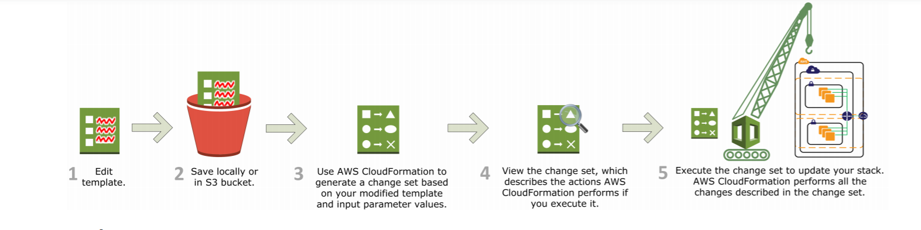
Using Change Sets with Stacks
Updating or Modifying stack's resources is very simple.
Updating a stack can be easily done by creating a change set by submitting a modified version of the original stack template, different input parameter values, or both.
AWS CloudFormation compares the modified template with the original template and generates a change set.
The change set lists the proposed changes.
After reviewing the changes, one can execute the change set to update the stack or you create a new change set.

Slide 51
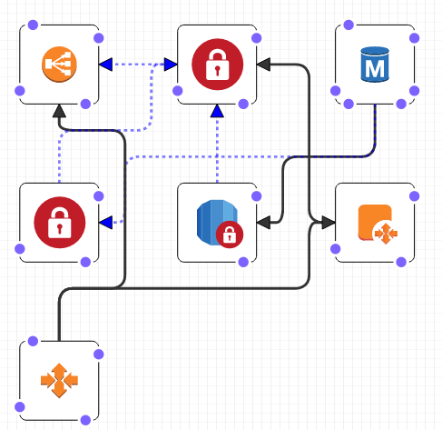
Overview of CloudFormation Designer
AWS CloudFormation Designer (Designer) is a graphic tool for creating, viewing, and modifying AWS CloudFormation templates.
Easily create the template , using a drag-and-drop interface, and then edit their details using the integrated JSON and YAML editor.
AWS CloudFormation Designer helps to quickly see the interrelationship between a template's resources and easily modify templates.

Slide 52
Benefits of using CloudFormation Designer
Allows to see graphic representations of the resources in your template, it simplifies template authoring, and it simplifies template editing.
Graphic representation of the resources that are included in a template and how they relate to each other provides.
Designer defines the information about your resources, such as their size and relative position, in template metadata.

Slide 53
Thank You

